Slide 1

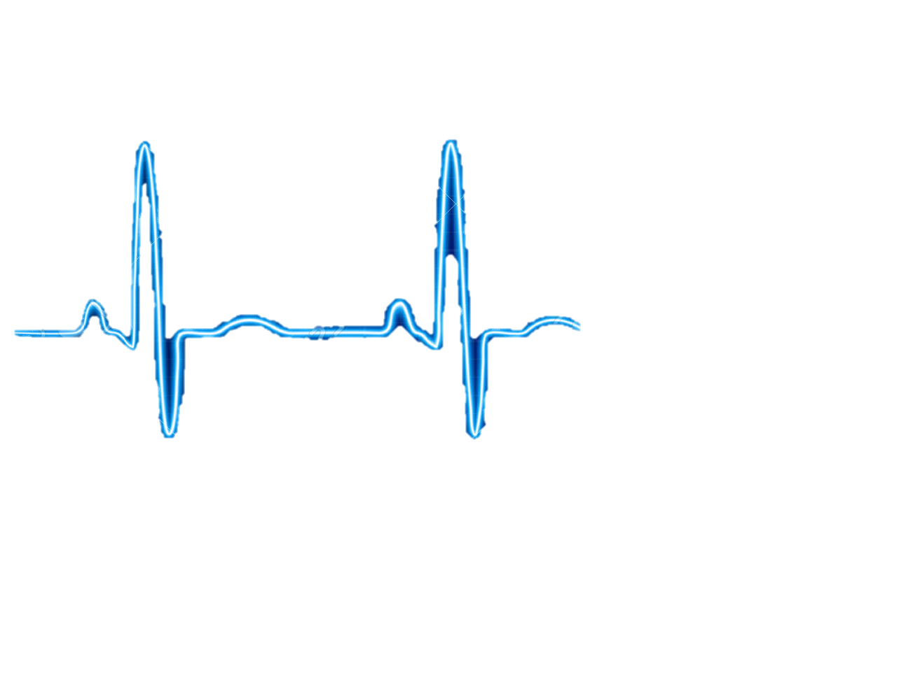
Prototype Check 3
CARDIOVASCULAR TEAM
Qingbo Kang
Arthur Kohler
Chantelle Janeiro
Naghmeh Bandari
March 21, 2018

Slide 2
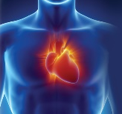

Need Statements
A way to determine the size of a heart valve, in patients with cardiac valve dysfunction in order to: increase the accuracy and speed of choosing the proper valve; and decrease hospital expenditure and post-operative complications of transcatheter valve replacement.

Slide 3
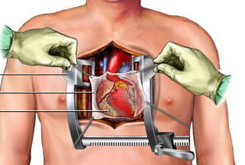
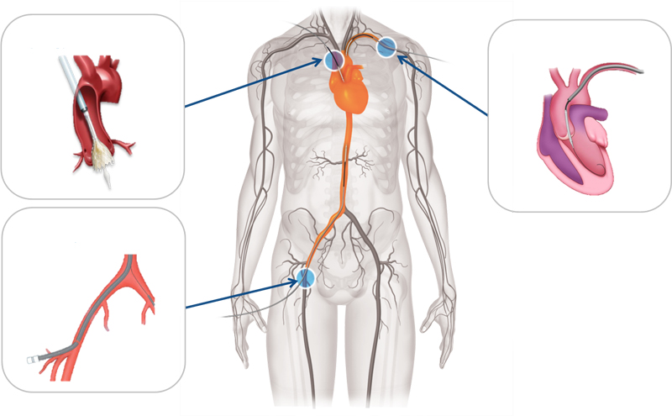
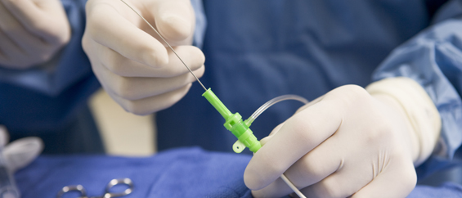
Treatment for Heart Valve Disorder
Transcatheter Valve Replacement
Open Surgery
Stop heart beating
Use of heart-lung machine
Several weeks of recovery
Less pain
Less infection
Low-risk patients may leave same day

Slide 4
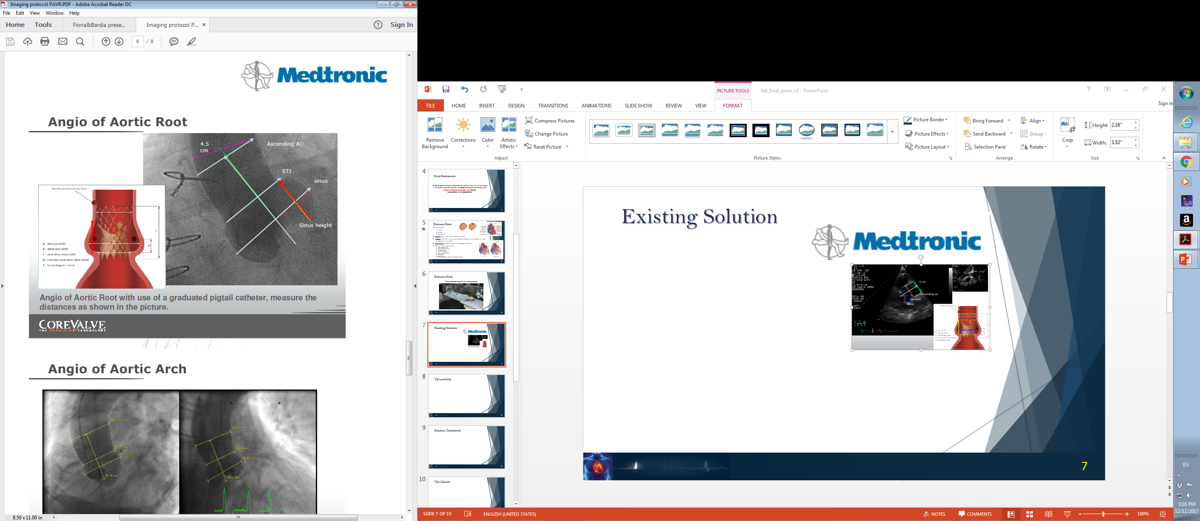
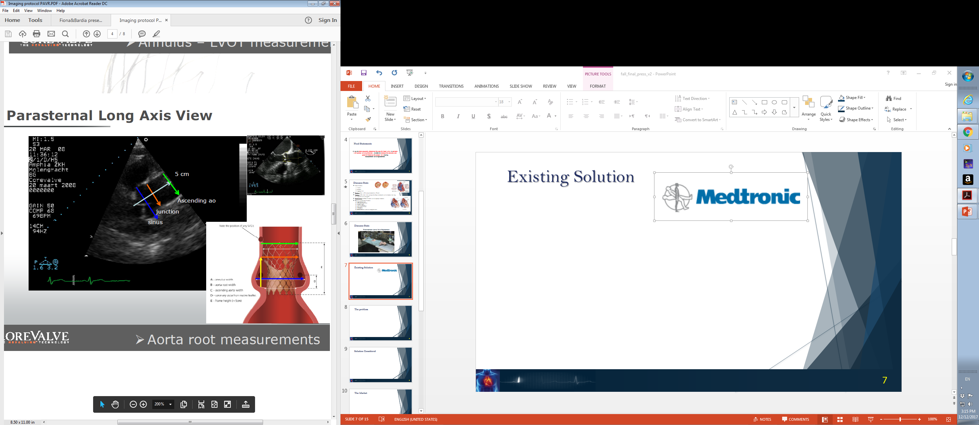
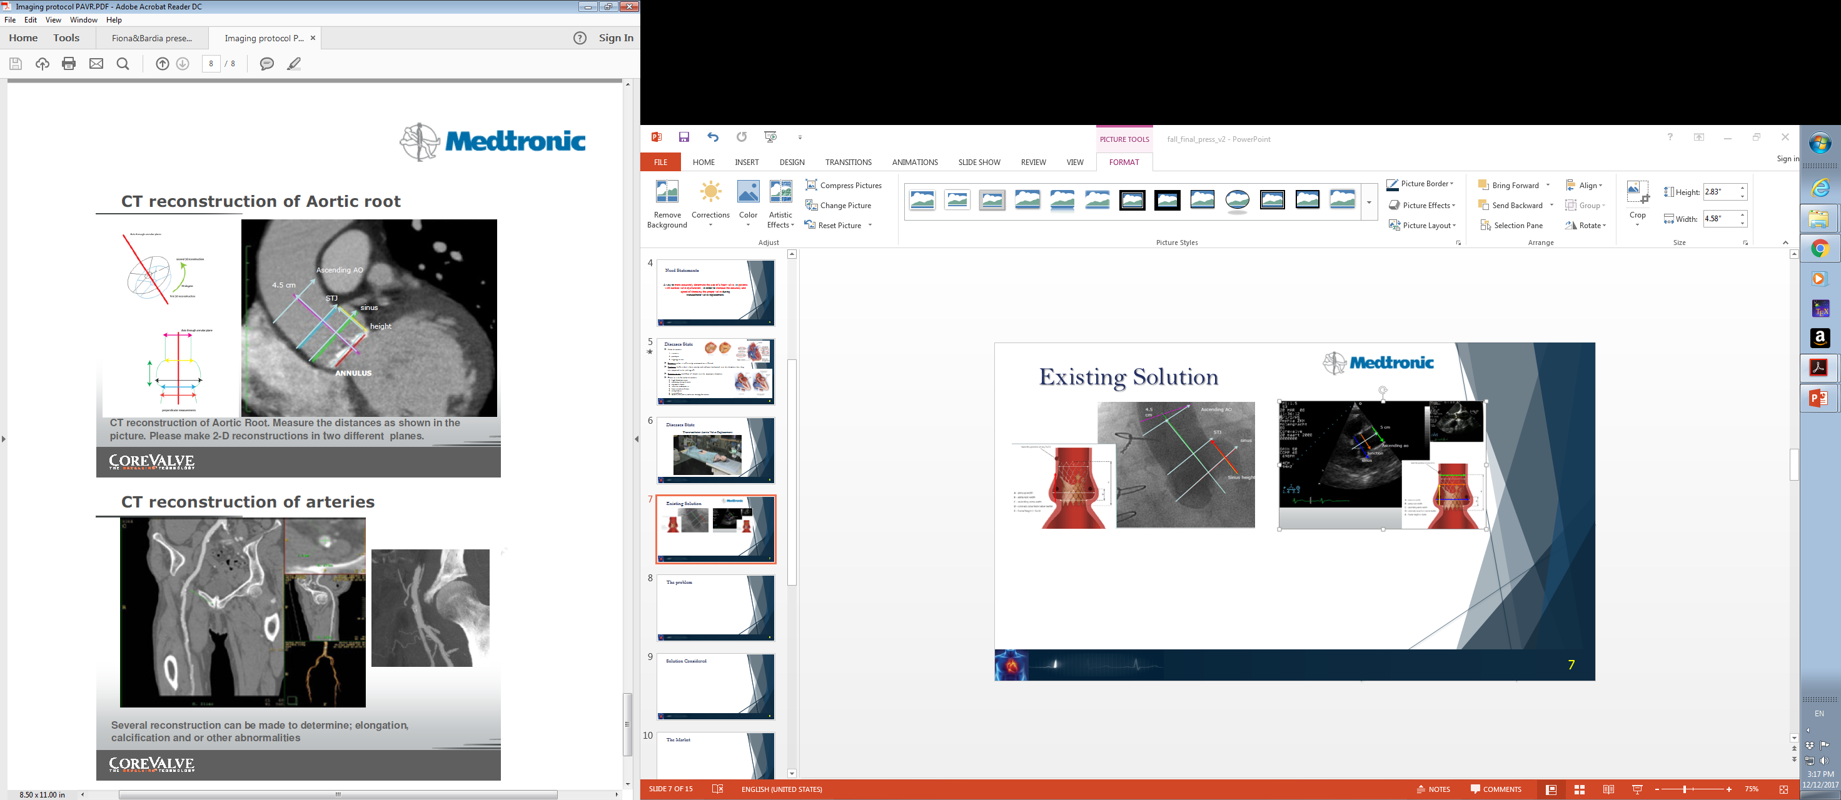
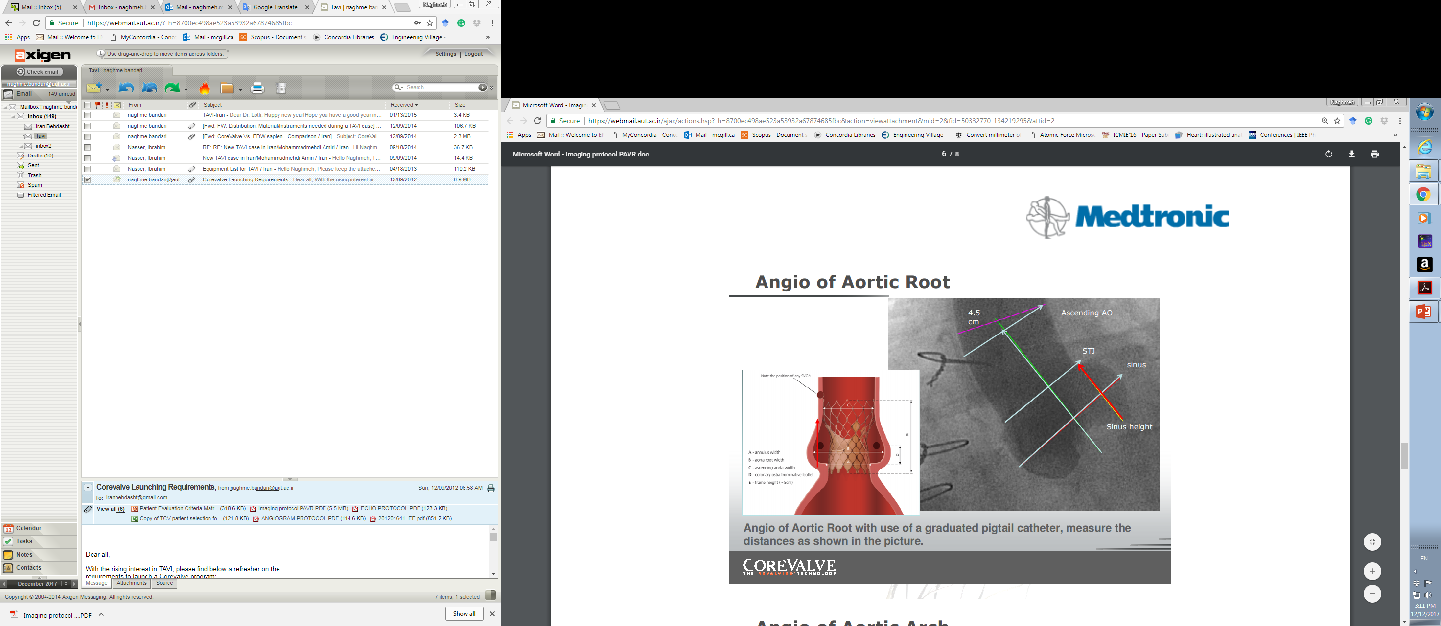
Existing Solutions
Contrast Angiogram
Echocardiography
CT Reconstruction of Aortic Root

Slide 5
Mechanical Design
“AnnuloFit”

Slide 6
Sensing Principle
Light Source
x
x
Multiple points
x
x
Continuous Sweep
Quarter Sweep
Optical Processing

Slide 7
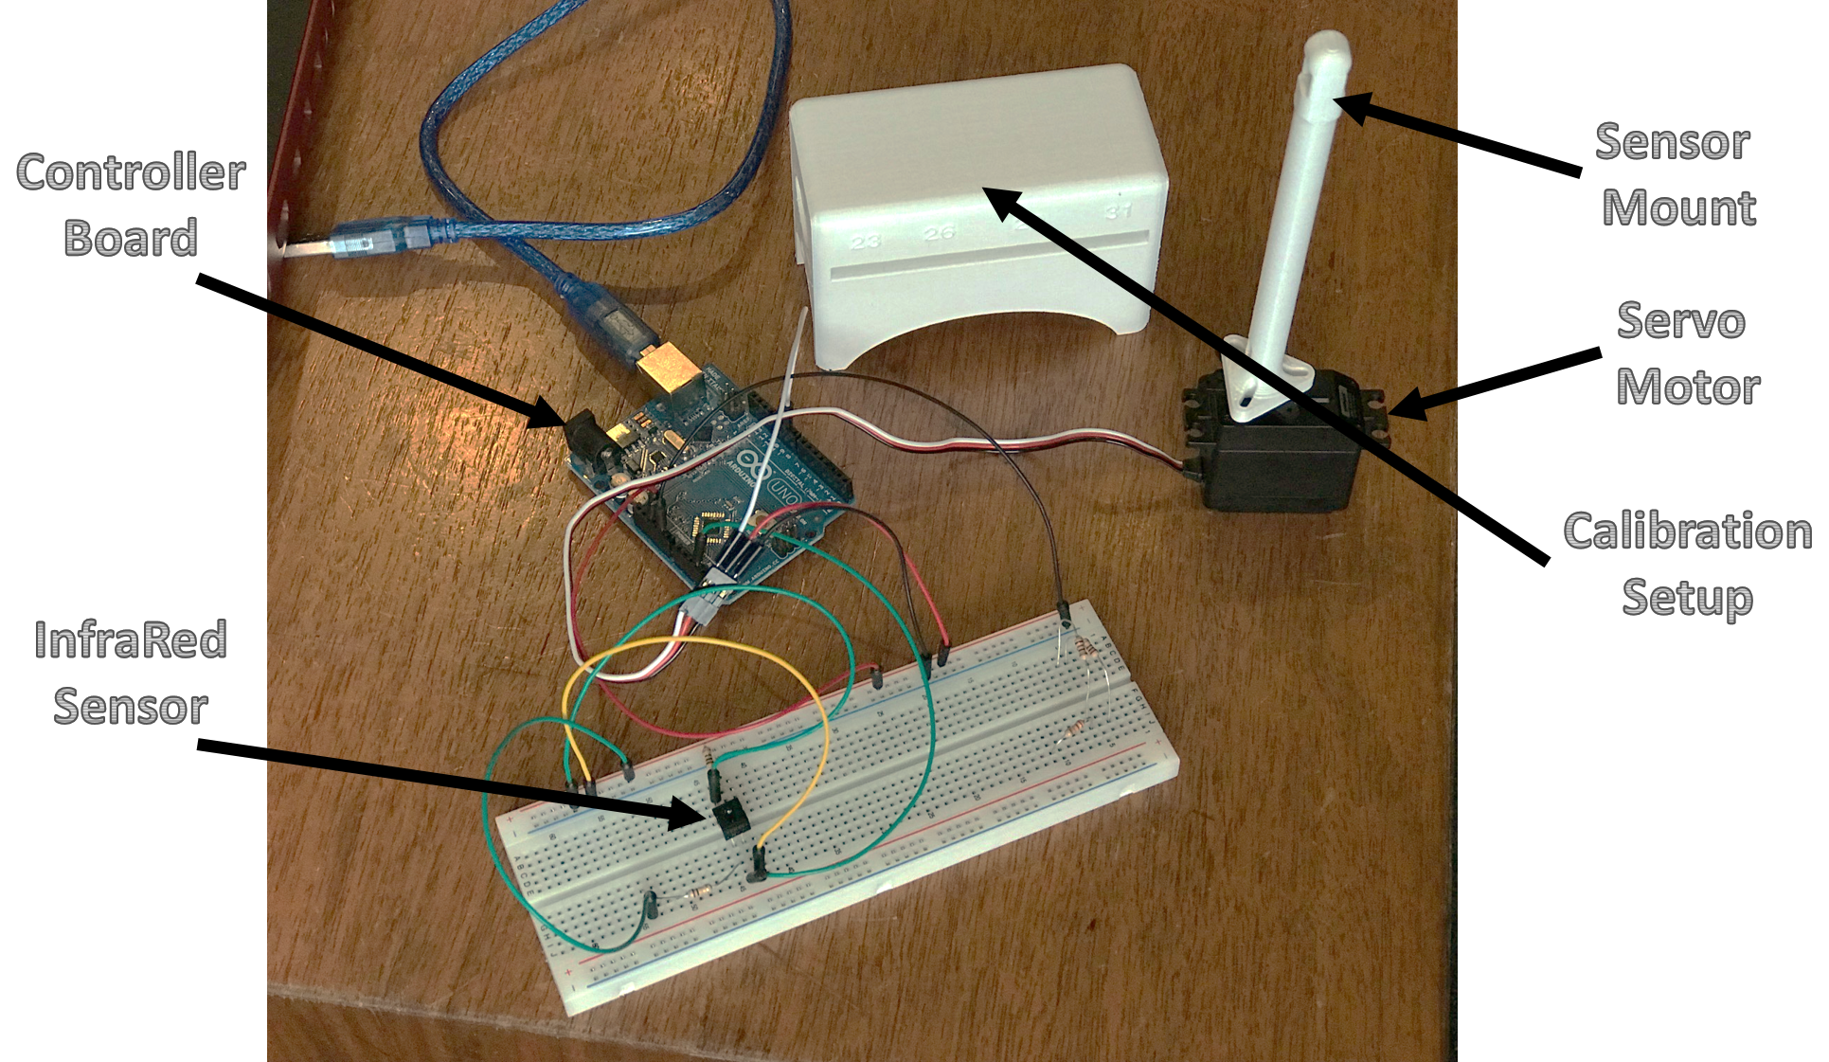
Experimental Setup – Sensor Calibration and Validation
11

Slide 8
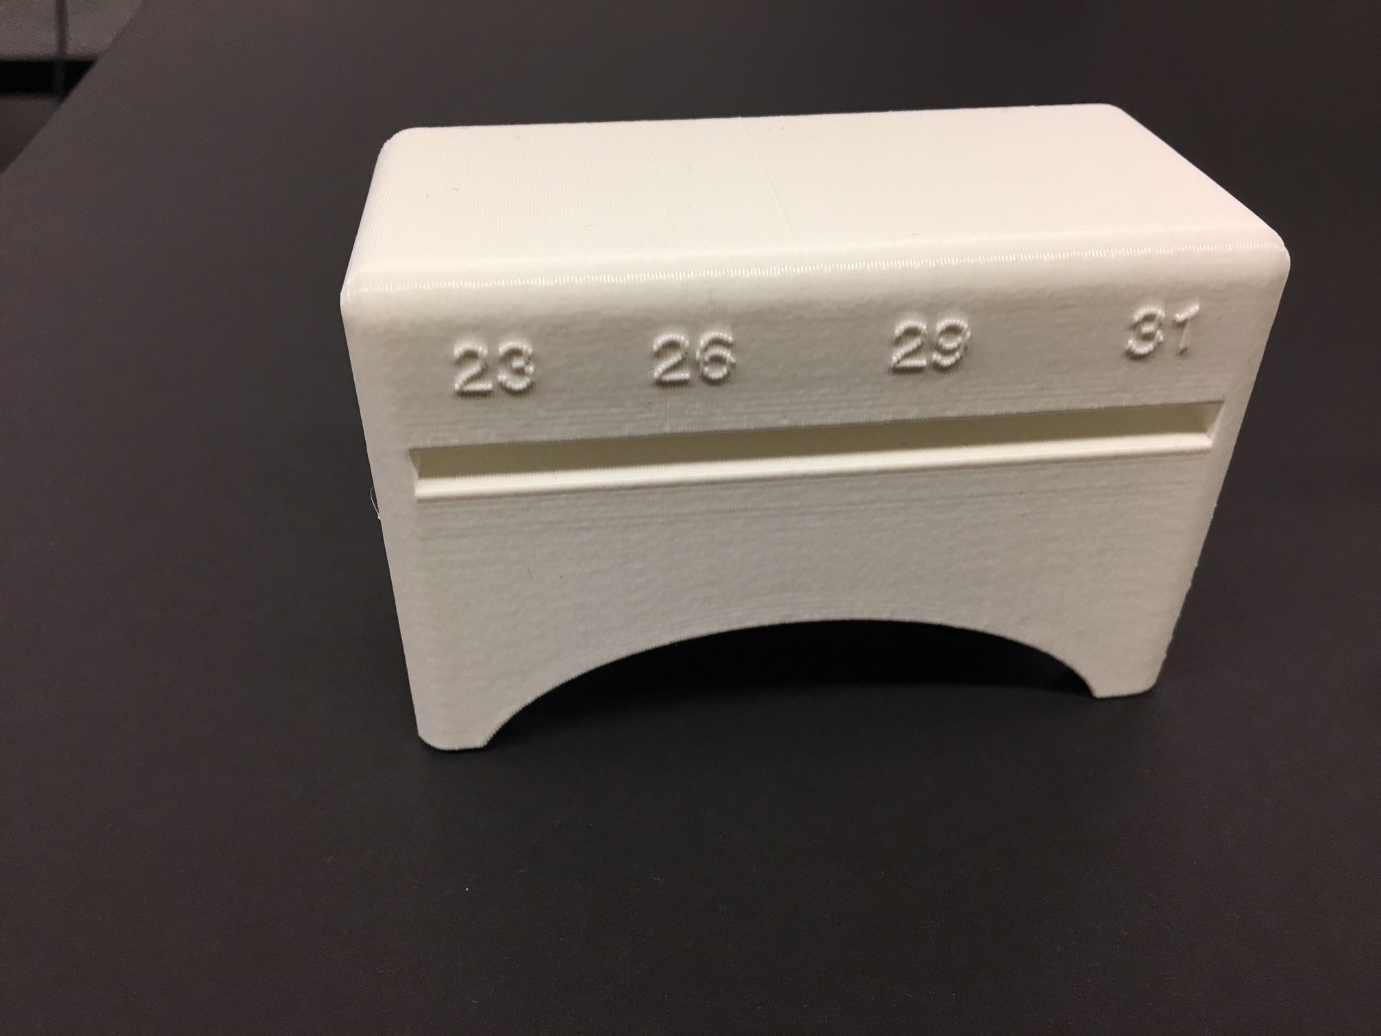
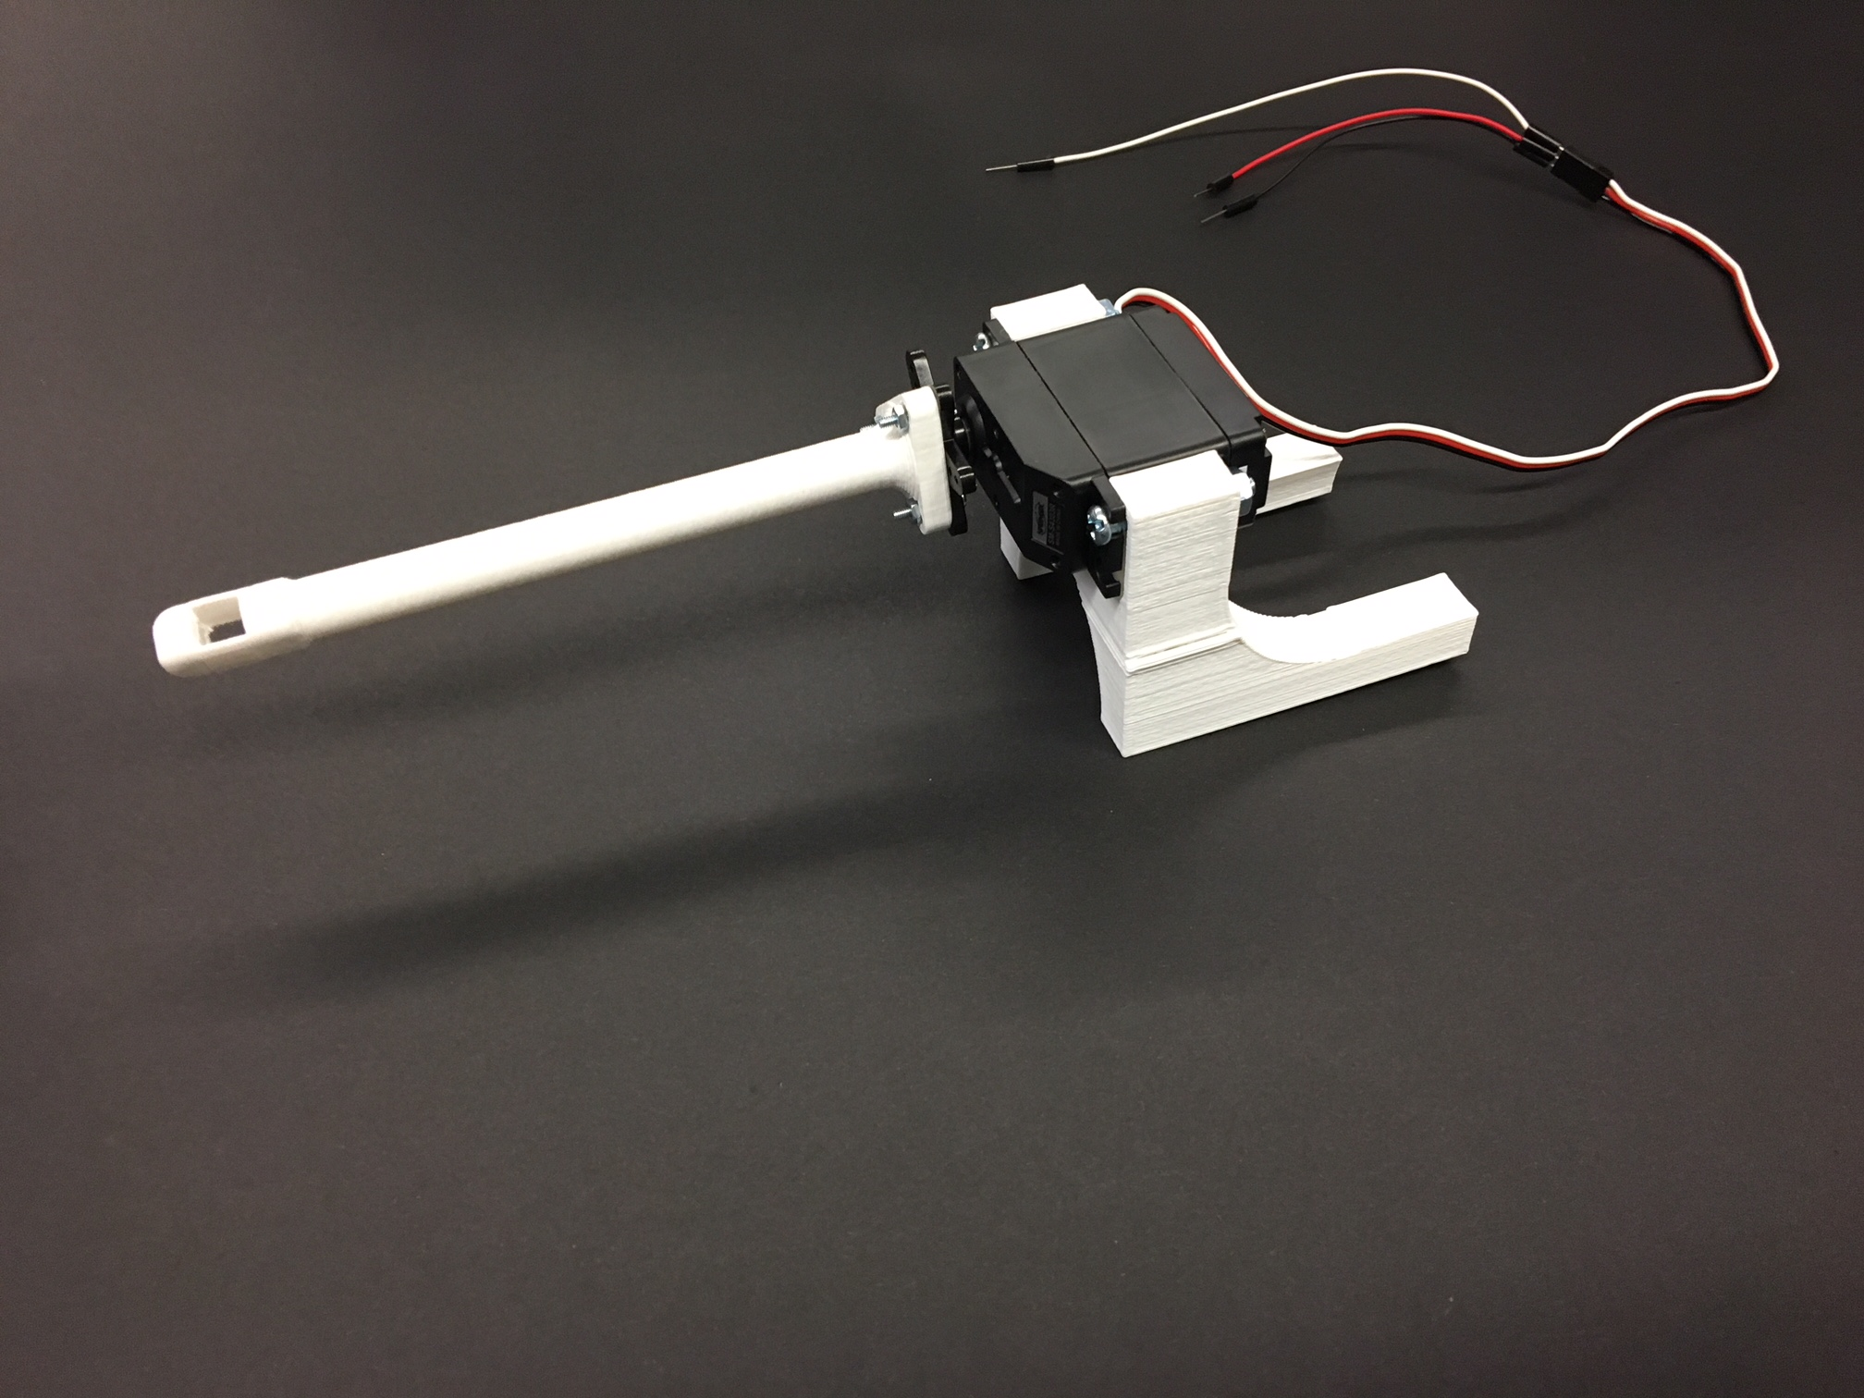
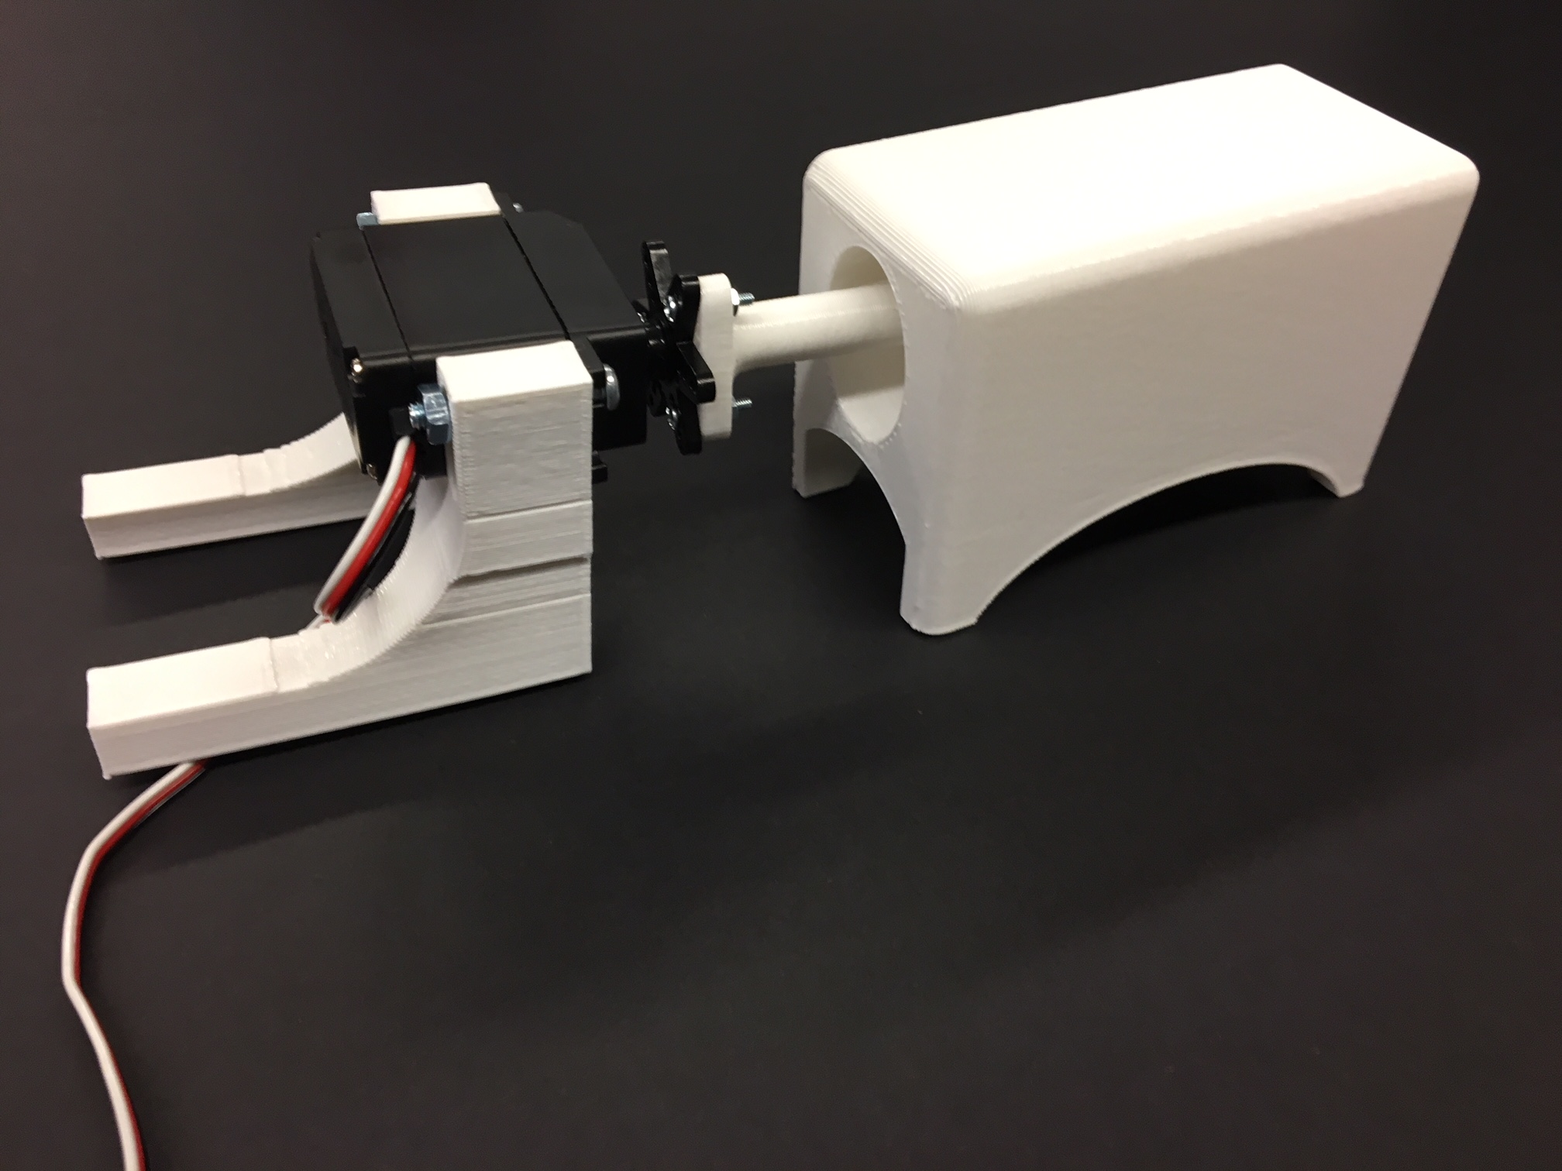
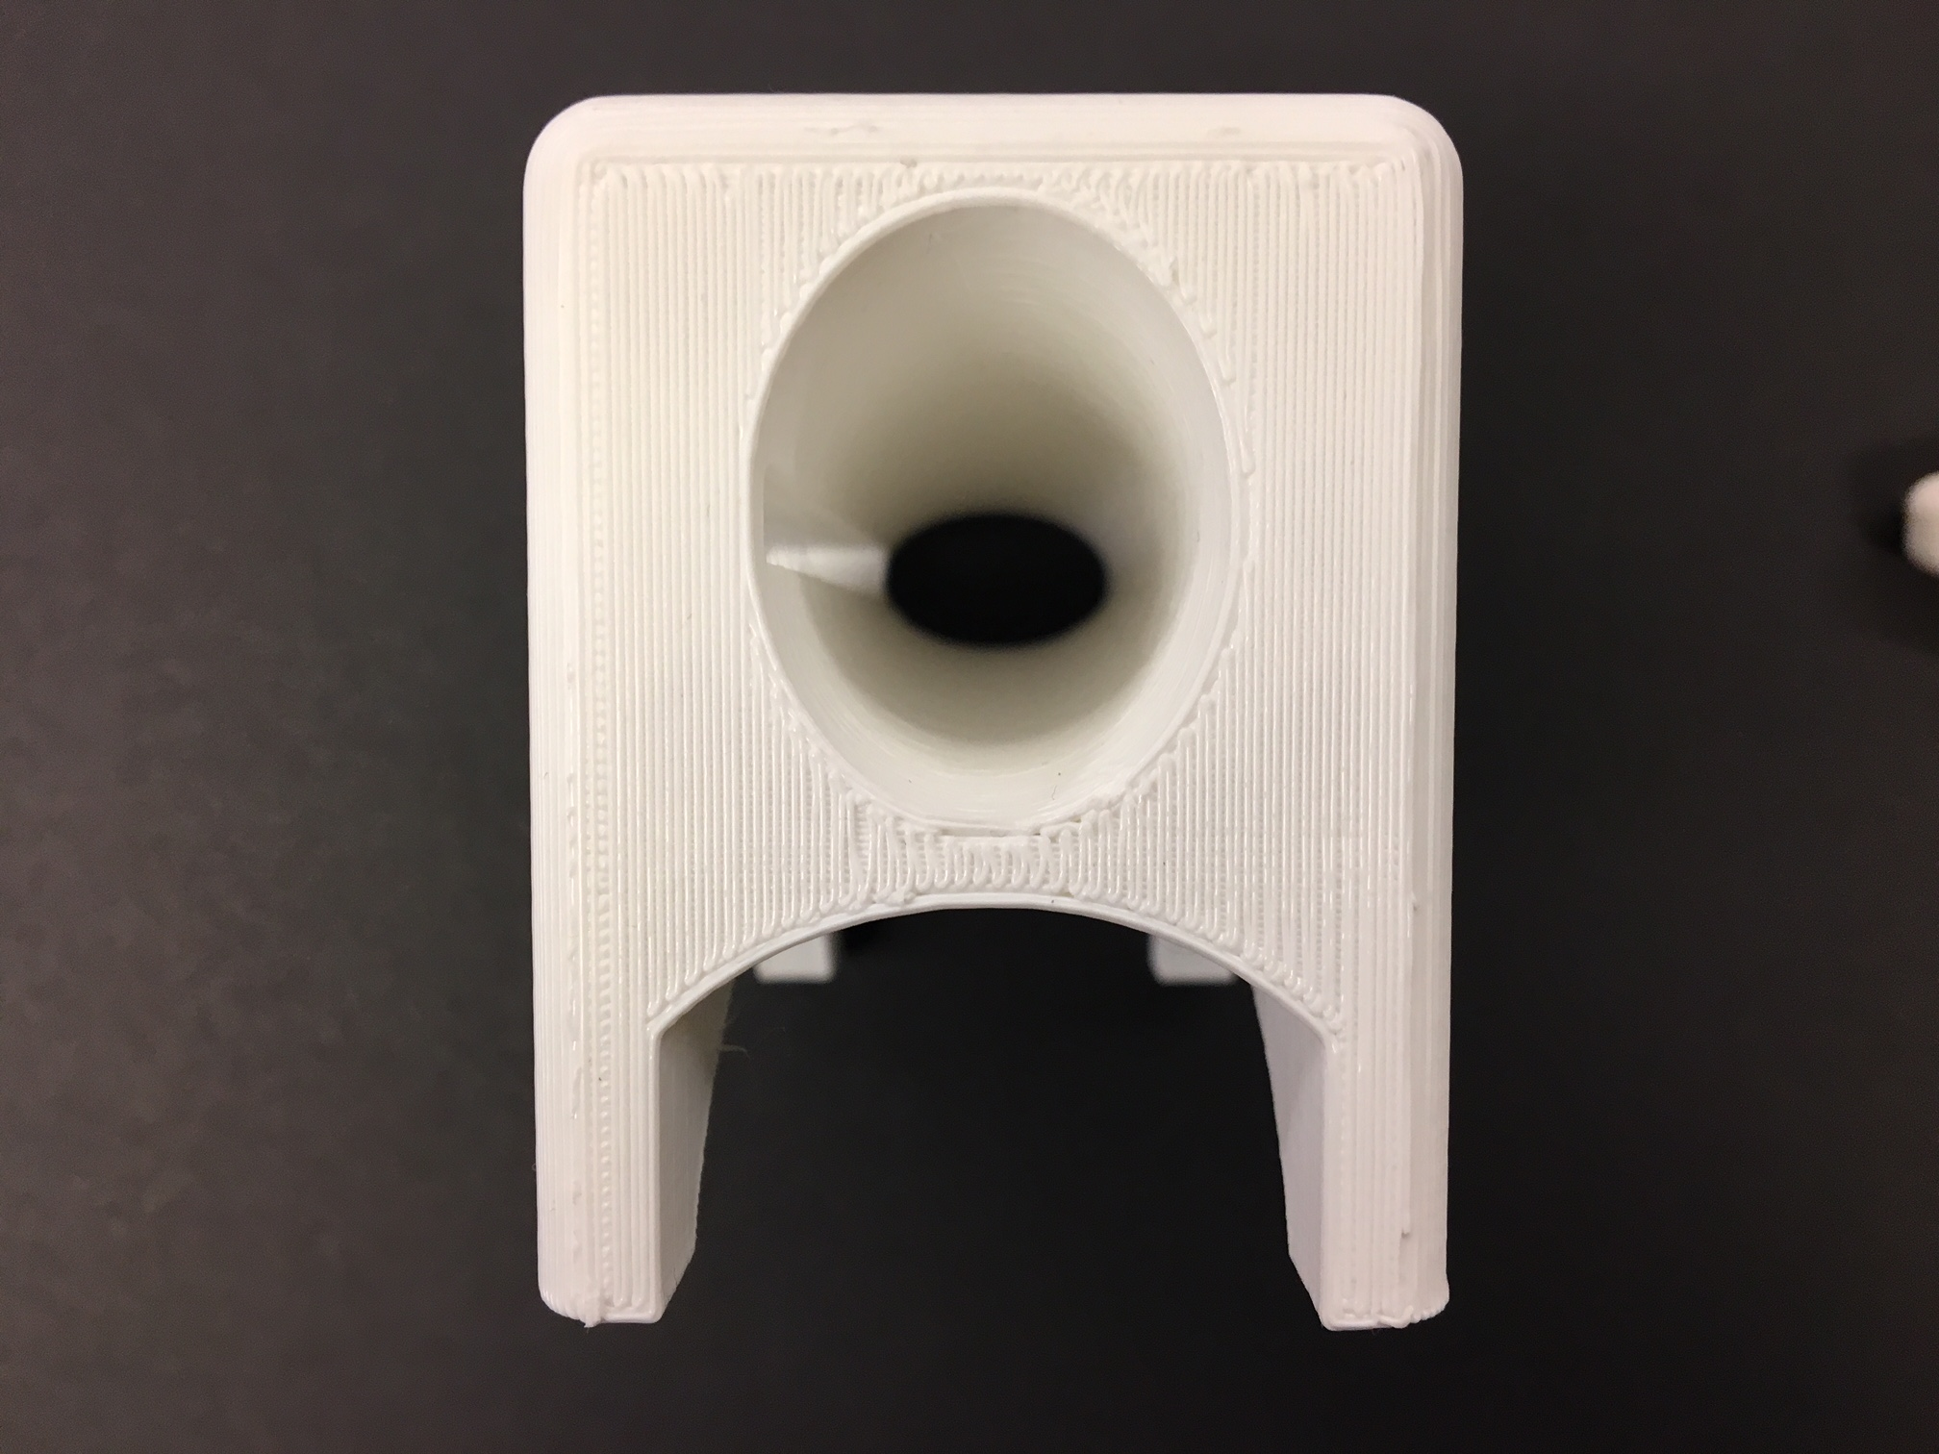
Experimental Setup – Sensor Calibration and Validation
+
=

Slide 9
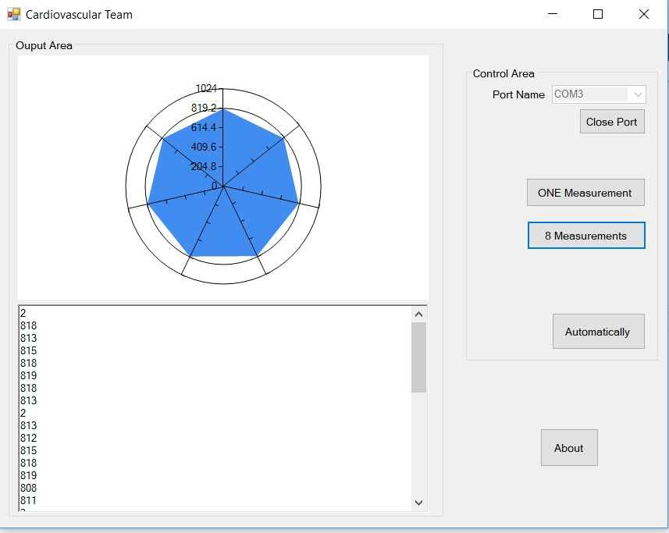
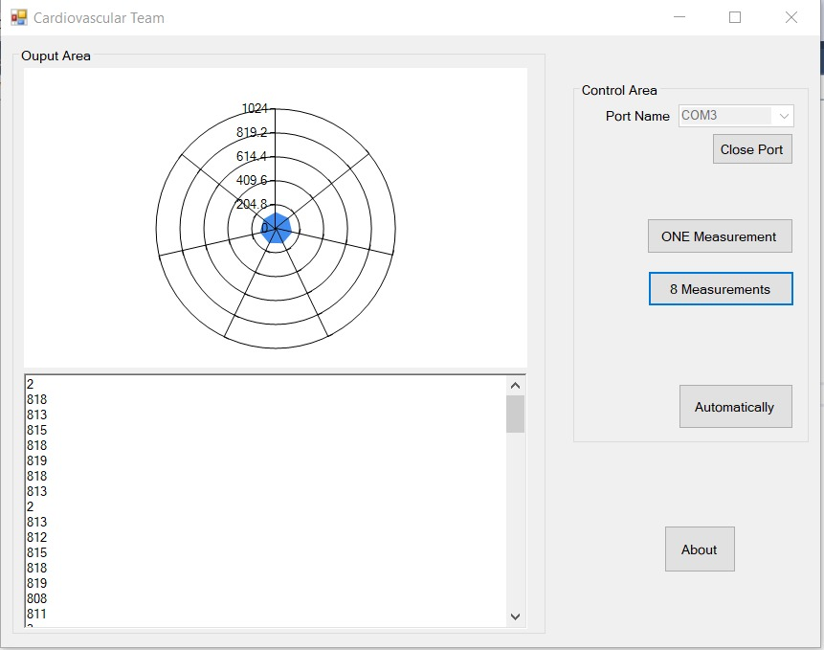
Output

Slide 10
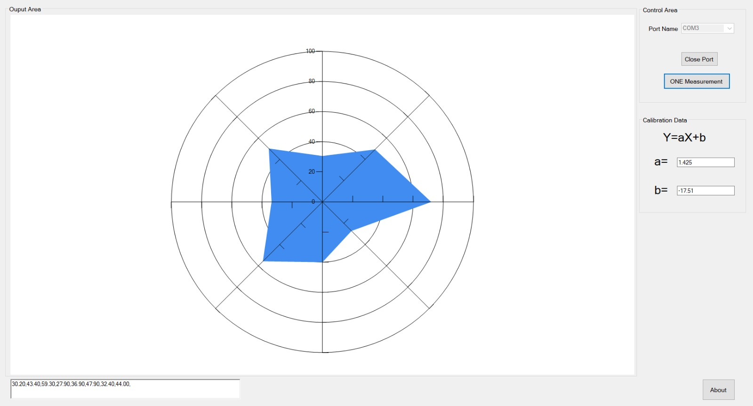
Output

Slide 11
Next Steps
Increasing accuracy of the software
Inserting sensor into an opaque balloon and comparing results
Testing the sensor on different types of meat (fatty vs. lean portions)
In vivo work with pig heart

Slide 12
CARDIOVASCULAR TEAM
Thank You…

